Slide 1
Tutorial 3 Introducing Cascading Style Sheets

Slide 2
Objectives 3.1
Understand the advantages of using CSS
Define a style rule
Apply color using CSS
Create internal and external style sheets
Change the appearance of a link using CSS

Slide 3
Objectives 3.2
Explore the five generic fonts
Understand the importance of using Web-safe fonts
Change the size and decoration properties of text
Manipulate the letter spacing, word spacing, and line height of text
Set the first line indentation and change text to uppercase using CSS
Set alignment to center text horizontally

Slide 4
Introducing CSS
Cascading Style Sheets (CSS) is used to format Web pages.
CSS offers many advantages, including:
greater consistency in your Web page
easily modified code
more flexible formatting

Slide 5
History of CSS
CSS1 (1996) enabled users to set font size; align text center, left, or right; set body margins; and apply background and foreground colors to page elements.
CSS2 (1998) included features such as design styles for different output devices such as print media and aural devices, and controlling the appearance and behavior of browser features.
CSS3 (2005) includes text effects such as drop shadows and Web fonts, semitransparent colors, box outlines, and rotating page elements.

Slide 6
Defining a Style Rule
Using CSS, you can change how an HTML element appears in browsers.
A style rule is the combination of a selector, a property, and a value.
The property is the name of a specific feature.
The property value provides a setting for the associated feature.
The selector identifies the element to which you are applying a style.

Slide 7
The Structure of a Style Rule
selector { h1 {
property1: value1; color: yellow;
property2: value2; text-align: center;
property3: value3; }
…
}
A style sheet is a collection of one or more style rules, either within an HTML document or in a separate CSS document.

Slide 8
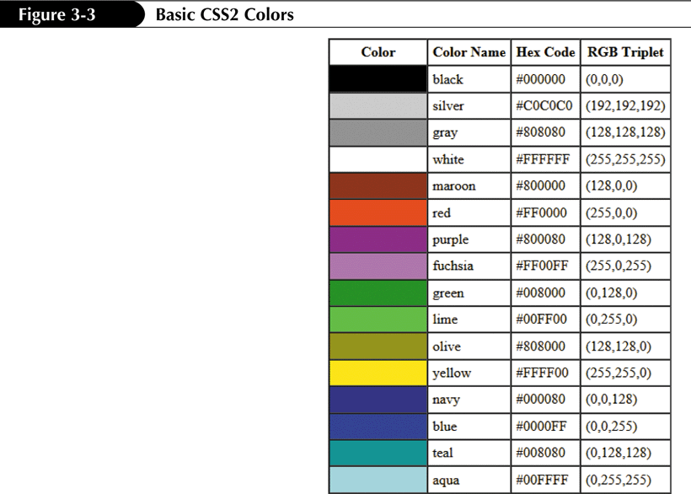
Defining Color
16 basic color names are standard in CSS2; a more extensive list of color names was incorporated in CSS3.
color: color-value;

Slide 9

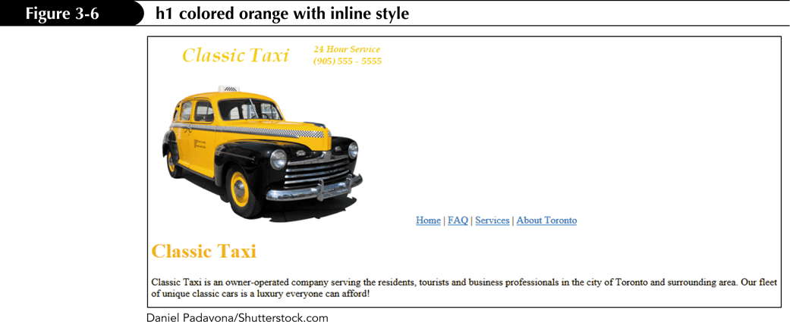
Implementing Inline Styles
An inline style rule is a style rule that is embedded inside an HTML start tag.

Slide 10
Embedded Style Sheets
The inline style method is discouraged because the power of CSS is its ability to separate the presentation (styles) from the content.
An embedded style sheet is a set of style rules contained between the <style> start tag and the </style> end tag in the head section of an HTML document: <style type = "text/css">
style rules
</style>

Slide 11
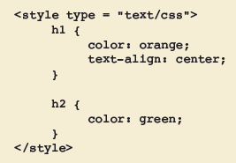
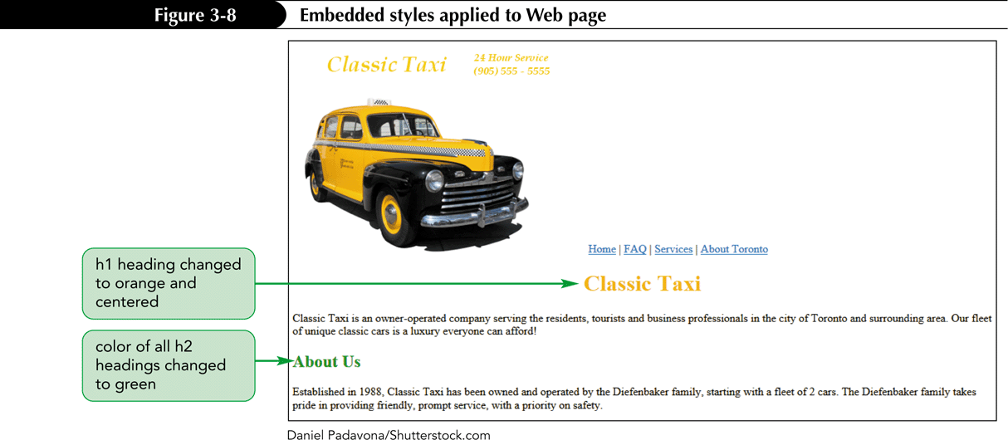
Embedded Style Sheets

Slide 12
External Style Sheets
If styles are to be used across several pages in a Web site, it’s much more efficient to create a separate document that contains the styles, known as an external style sheet.
Then you should use the link element to link the external style sheet to the Web pages.
Comments should be used in style sheets to describe information about the style and to identify its sections.

Slide 13
Background Color
Background color can be defined for most elements.
The background color for heading elements extends across the Web browser window.
The background color can be defined as background-color: color_value;
The color value could be the CSS color name, the hex code, or the RGB triplet.

Slide 14
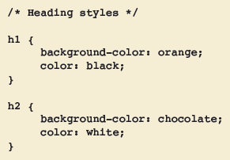
Background Color
Setting the text color as black in a CSS rule ensures the text will be displayed as black.
Style rules are added to the xxx.css style sheet and then this file is linked to the index.htm Web page.

Slide 15
The link Element
After linking the external style sheet to the Web page, the styles are applied to the elements in the Web page.
One style sheet can be linked to many Web pages.
More than one style sheet can be linked to the Web page.
The link element is used to link an external style sheet to a Web page.

Slide 16
The link Element
The link element is placed in the head section of the HTML code: <link href = "url" rel = "stylesheet" type = "text/css" />
url refers to the URL of the external style sheet file.
rel = "stylesheet" identifies this link item as a style sheet.
type = "text/css" identifies it as a CSS text file.

Slide 17

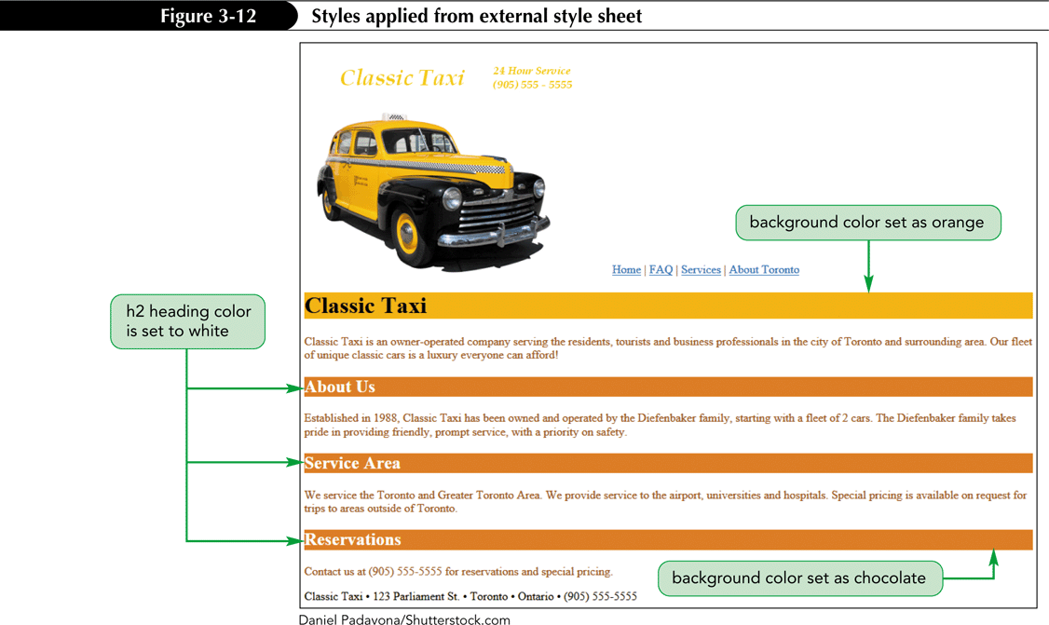
The link Element

Slide 18
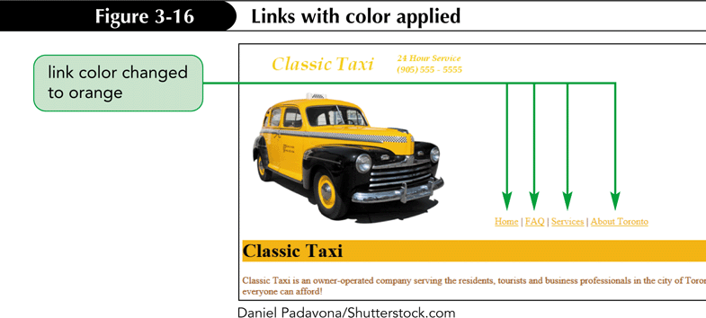
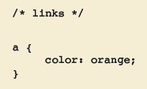
Defining a Style for Links
By default, links are underlined and blue.
You can change the color of the links using the color property.

Slide 19

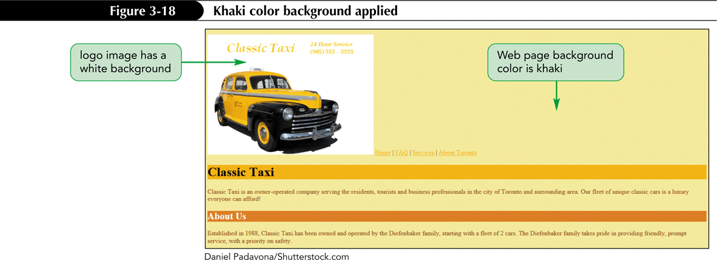
Changing the Page Background

Slide 20
Font Families
A font is the recognizable, distinct design of a collection of characters in a particular typeface.
A font family is a set of fonts that have similar characteristics.
A generic font attempts to duplicate as many features of a specific font as possible.
There are five generic fonts used in Web page design: serif, sans-serif, monospace, cursive, and fantasy.

Slide 21
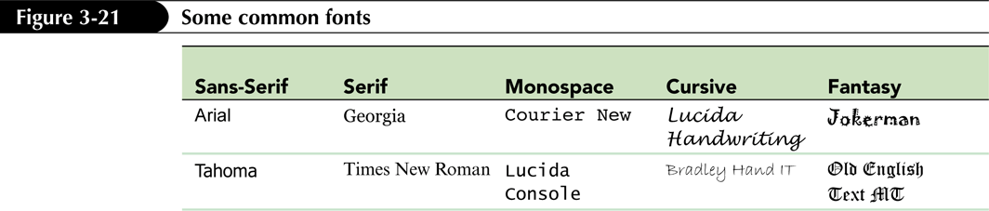
Font Families
Generic fonts are designed to be cross-platform.
The letters in a serif font have finishing strokes.
A sans-serif font lacks finishing strokes.
A monospace font has a fixed letter width.
A fantasy font is artistic and decorative.
Cursive fonts resemble handwritten letters.

Slide 22
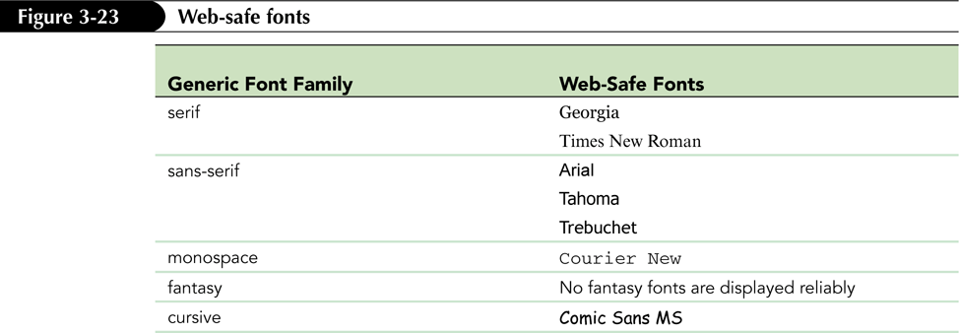
Web-safe Fonts
Web-safe fonts are displayed reliably in most Web browsers on most devices.

Slide 23

The font-family Property
The font-family property is used to change the typeface of text: font-family: Font1, Font2, . . . , GenericFont;
The most common font-family style properties:

Slide 24
Setting the Font Size
The style used to change the font size: font-size: size;
The font size can be expressed in:
centimeters (cm)
inches (in)
millimeters (mm)
points (pt)
picas (pc)
pixels (px)
x-height (ex)
em
percentages
absolute units
relative units
New Perspectives on Blended HTML and CSS Fundamentals, 3rd Edition

Slide 25
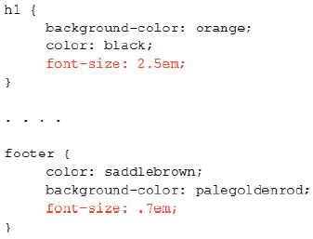
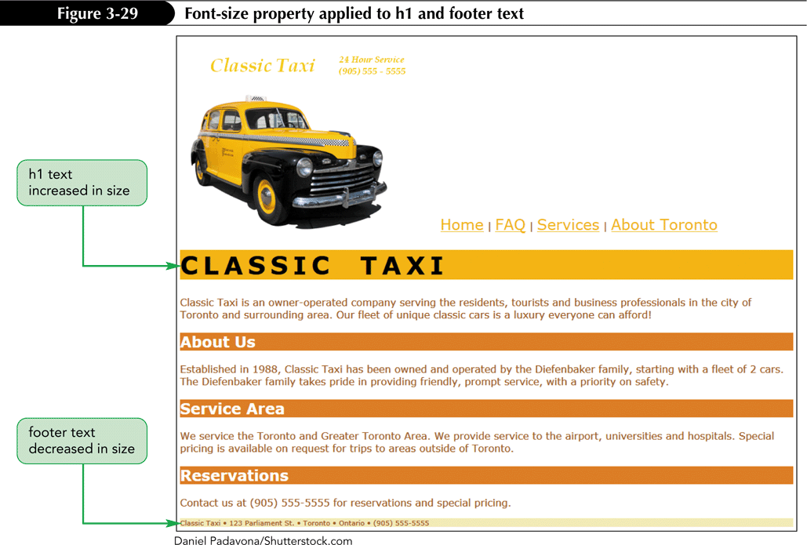
Setting the Font Size
New Perspectives on Blended HTML and CSS Fundamentals, 3rd Edition

Slide 26
Transforming Text
Many browsers can transform text to all uppercase characters using the text-transform property.
The property’s values are:
capitalize (Text Appears With The First Letter Of Each Word Capitalized)
lowercase (text appears in lowercase)
uppercase (TEXT APPEARS IN ALL CAPS)
none (removes any of the preceding values)

Slide 27
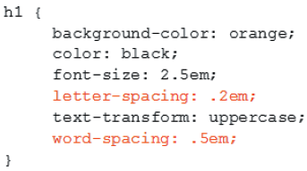

Creating a Spread Heading
The letter-spacing property controls the amount of white space between letters: letter-spacing: letter_spacing_value;
The word-spacing property controls the amount of white space between words: word-spacing: word_spacing_value;

Slide 28
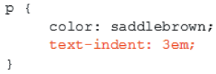
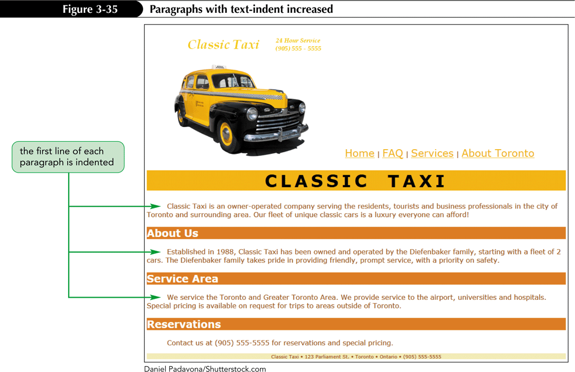
Indenting Text
Use the text-indent property to indent the first line of paragraph text: text-indent: value;

Slide 29
Adjusting the Line Height
Single and double spacing are examples of line height, which is the vertical spacing between lines of text.
By default, Web browsers use 1.0em or 1.2em line height.
The style used is: line-height: value;

Slide 30
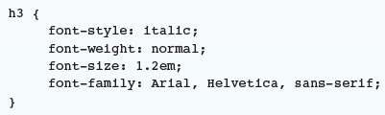

Using the font Shorthand Property
The font property is one of several CSS shorthand properties and is used to set a related group of properties in one declaration.
Values for the font properties must be listed in the following order: font style, font weight, font variant, font size, font family.

Slide 31
Text Alignment
The text-align property is used to change the alignment of the text.
The property’s values are:
left – Each line of text is flush with the left margin.
right – Each line of text is flush with the right margin.
center – Each line of text is centered horizontally.
justify – Each line of text is flush with the left and right margins.

Slide 32
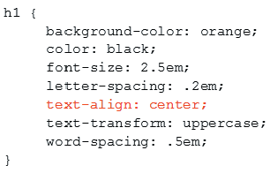
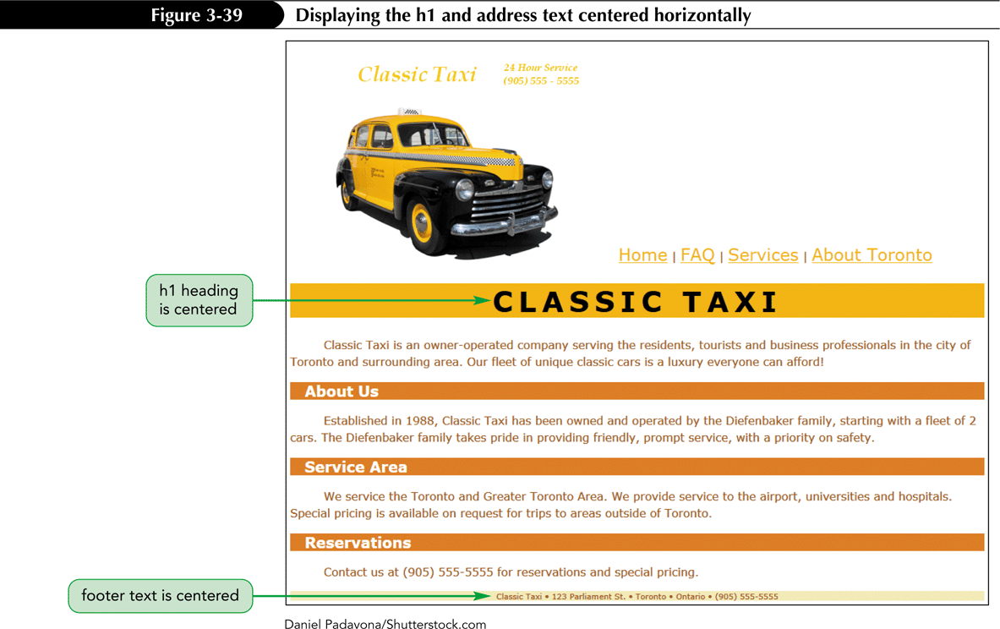
Text Alignment

Slide 33
Removing the Underlines on Links
Hyperlinks are underlined.
Underline is a text decoration and can be removed using the text-decoration property: text-decoration: value;
The property’s values are none, underline, or line-through.
The style to remove underlines on links: a {
text-decoration: none; }

Slide 34
Some Other font Properties
To set the font style to italic, use: font-style: italic;
To remove italic, use: font-style: none;
To set the font weight to bold, use: font-weight: bold;
To set the font weight to light, use: font-weight: light;

Slide 35
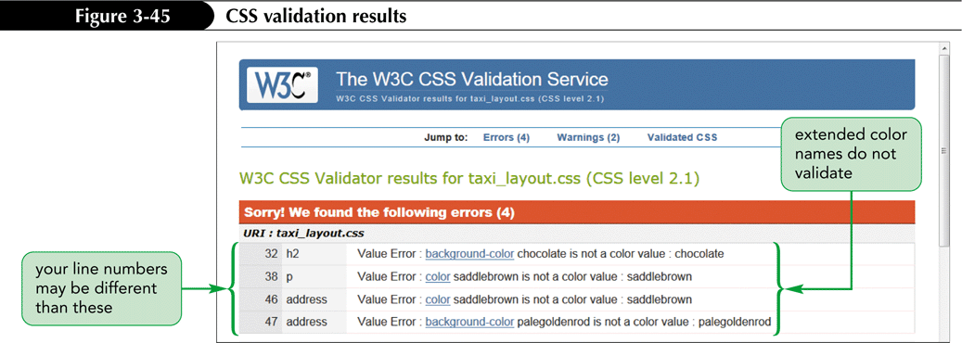
Validating the CSS Code
Navigate to http://jigsaw.w3.org/css-validator.
Use either the ‘By file upload’ or ‘By direct input’ method for validating a document.

